Slide 1
Principle of color
Sunny Lee / Mtafya & Jackson

Slide 2
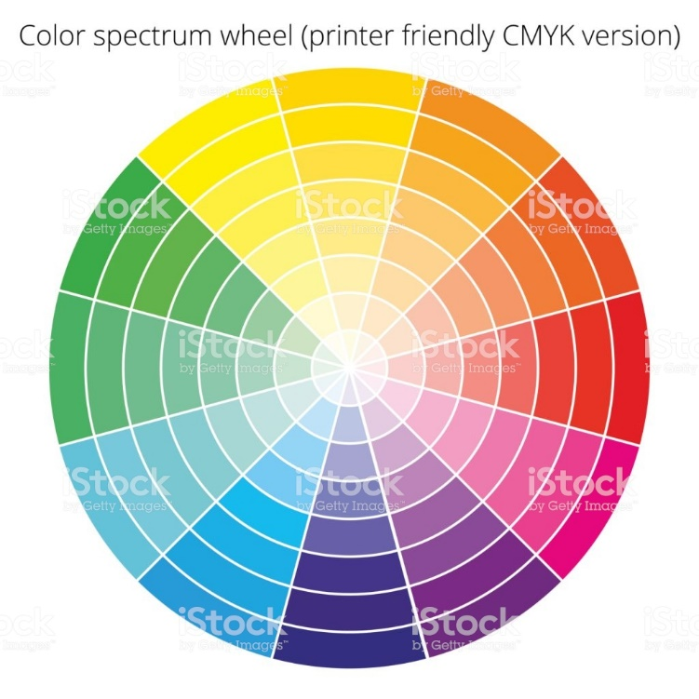
Background Question
What is the primary colors of light ?
What is the primary colors of pigment ?
What is the relationship between the primary colors of light and pigment ?
Notes:
Who decided the name of the color? Scientist? artist?
Newton is the first person to decide the color of the rainbow. Newton broke the orthodoxy that white is the primary color and said it is a mixture of multiple colors (A new theory of light and colours, 1671).
Understanding color is a concern of science before art.
I have a question
What is the primary colors of light ?
What is the primary colors of pigment ?

Slide 3
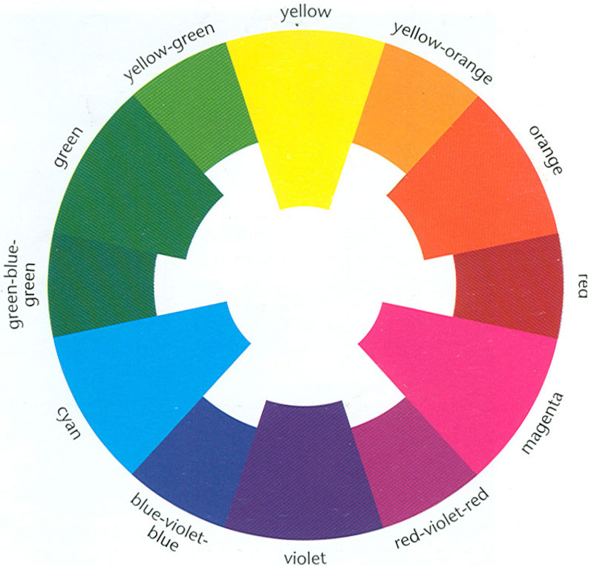
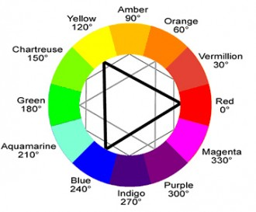
What is the primary colors of pigment
Notes:
This picture is on the internet.
What is true?
Of course one is right and the other is wrong. Is there anyone you can explain about this? These two palettes are widely used. I will discuss which is right after class again.

Slide 4
Background Question
What is the primary colors of light ?
What is the primary colors of pigment ?
What is the relationship between the primary colors of light and pigment ?
Notes:
What is the relationship between the primary colors of light and pigment ?
In elementary school, students learn that the primary colors of pigment are red, yellow, and blue. It does not deal with the relationship between light and color.
So a misconception occurs.
Misconceptions often arise because there is no understanding of the relationship between light and color.
Even science teachers often understand color and light separately.

Slide 5
Program Overview
order | Activity Topics | Time(min)
1 |  | 20
2 |  | 30
3 |  | 30
4 |  | 20
Who is the owner of the color?
Understanding the primary colors of light
(Basic) Using projector, monitor, or mobile phone screen
(Additional) Observing the monitor with Loupe
(Additional) Utilizing the Light Synthesis Device
The mixture of light and the mixture of colors
The principle of color printing
Notes:
This contents is for middle school students. Depending on the level of the student, you can add or subtract.
1. Who is the owner of the colors? : This is the basic process to understand the relationship between light and color.
2. Understanding the primary colors of light:
We deal with the primary colors of light.
We use some material- spectroscope, light source(projector, monitor, or mobile phone).
The added activities can be done according to the situation.
Today, we deal with “Basic”.
3. Color Mixing:
We deal with The principle of color mixing
and the relationship between primary colors of pigment and primary colors of light.
4. Principle of Color Printing:

Slide 6
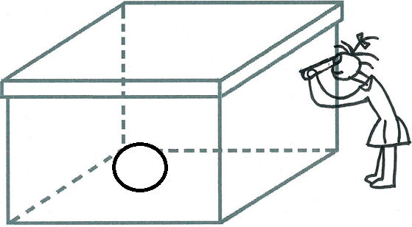
Activity 1. Who is the owner of the color?
Here is a box with a small hole.
Put a white table tennis ball in the box.
Cover the lid and watch the ball
through the hole in the box.
What is the color of the ball?
Good Light Source: https://javalab.org/en/color_panel_en/
Notes:
Please connect the site with your mobile phone.

Slide 7
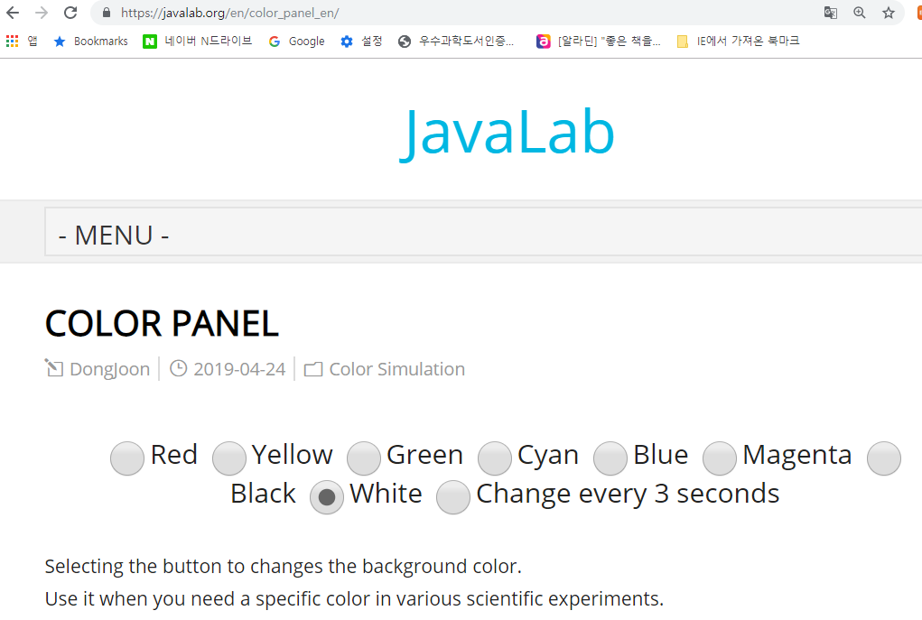
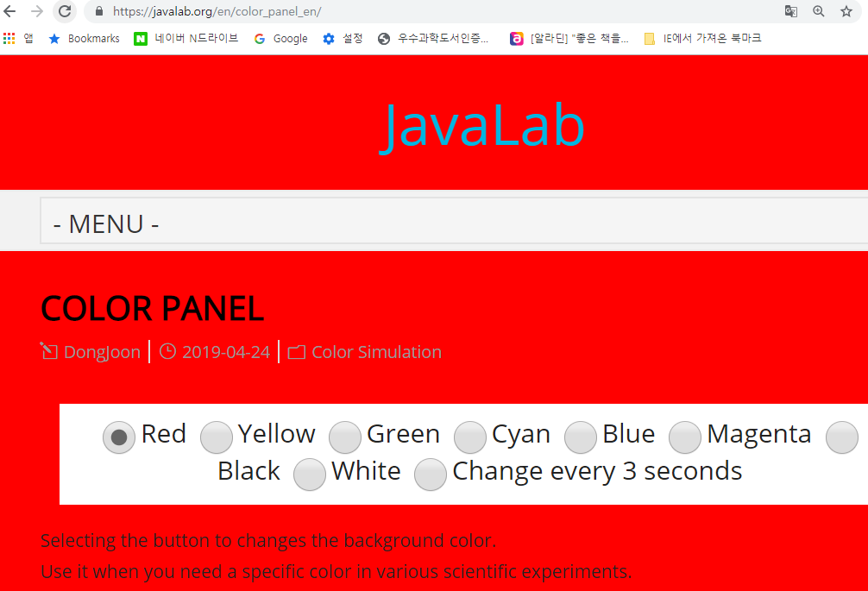
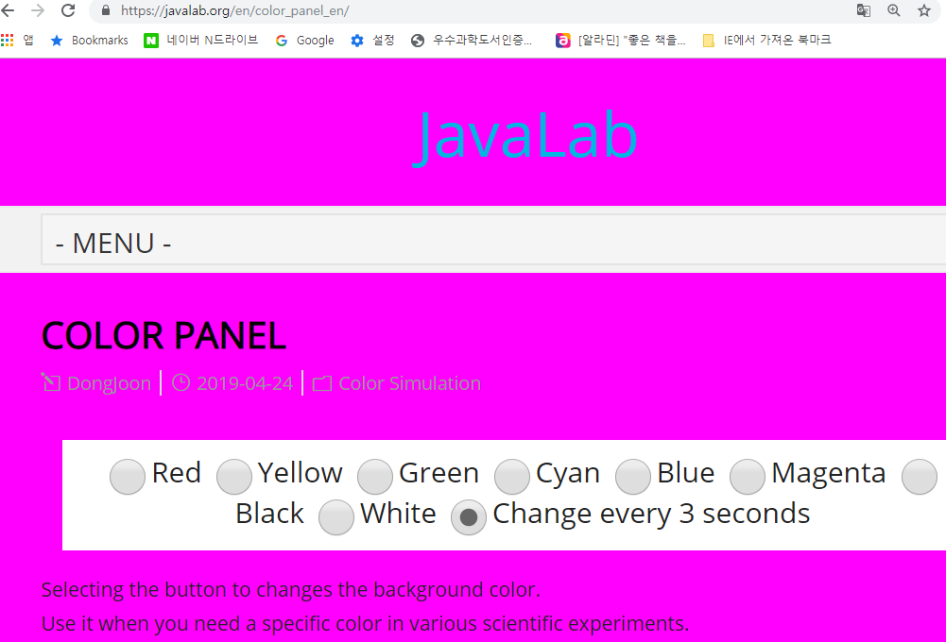
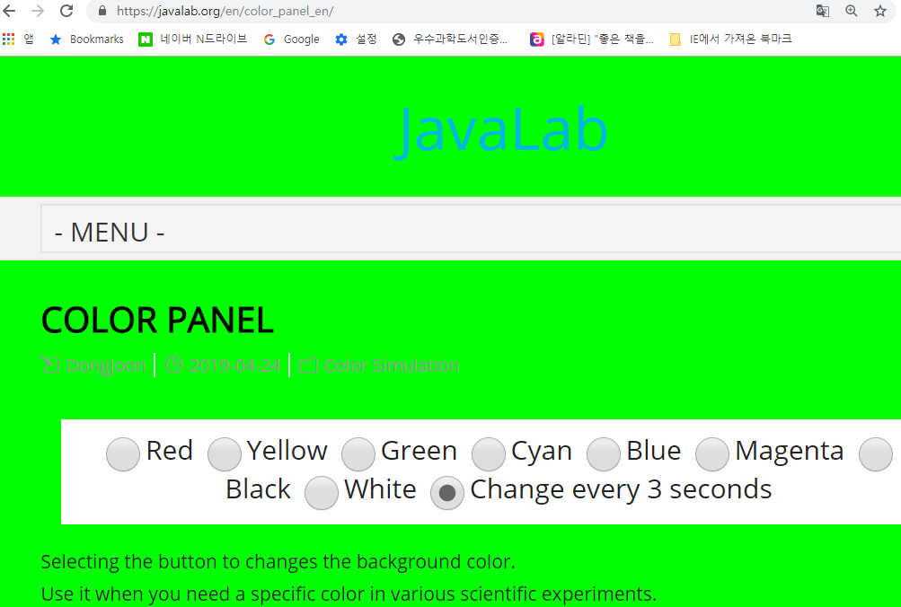

Slide 8
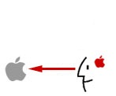
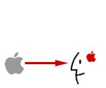
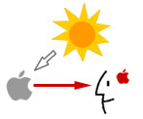
Activity 1. Who is the owner of the color?
Let's draw the process of recognizing the color of apples.
Notes:
Without light there is no color. The color depends on the light.

Slide 9
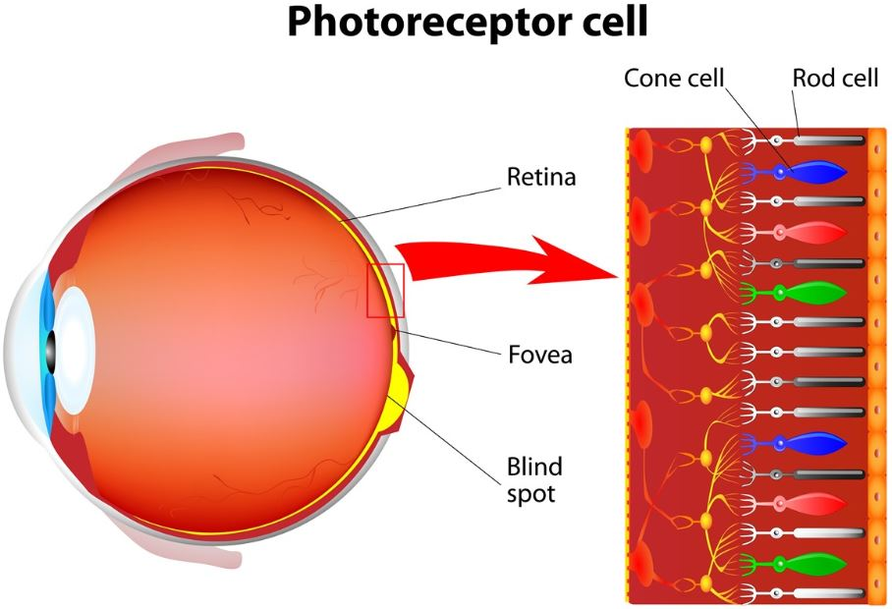
Activity 1. Who is the owner of the color?
(teacher)
the process of recognizing the color of apples.
Sun has all color.
White is not the primary color.
It is a mixture of multiple colors.
(Newton , 1671. A new theory of light and colours)
An object reflects a specific color. The rest absorbs.
Light stimulates a specific photoreceptor cell.

Slide 10
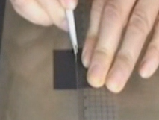
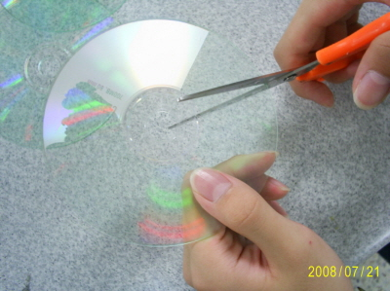
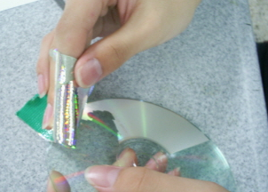
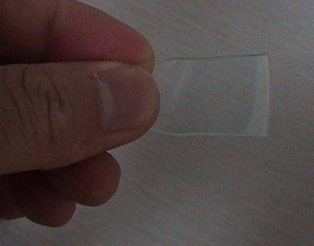
Activity 2. How many lights are needed to express all the colors?
Look at the sun with a spectroscope.
Making spectroscope
<Making a narrow gap of light> <Making multiple slit>

Slide 11
Activity 2. How many lights are needed to express all the colors?
Look at the sun with a spectroscope.
Principle of a spectroscope:
refraction or diffraction
Single slit : a sin θ = mλ, a= width of slit
Multiple slit: d sin θ = mλ, d= grating spacing

Slide 12
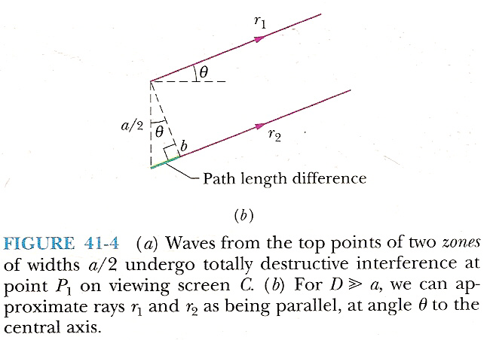
Activity 2. How many lights are needed to express all the colors?
Single slit

Slide 13
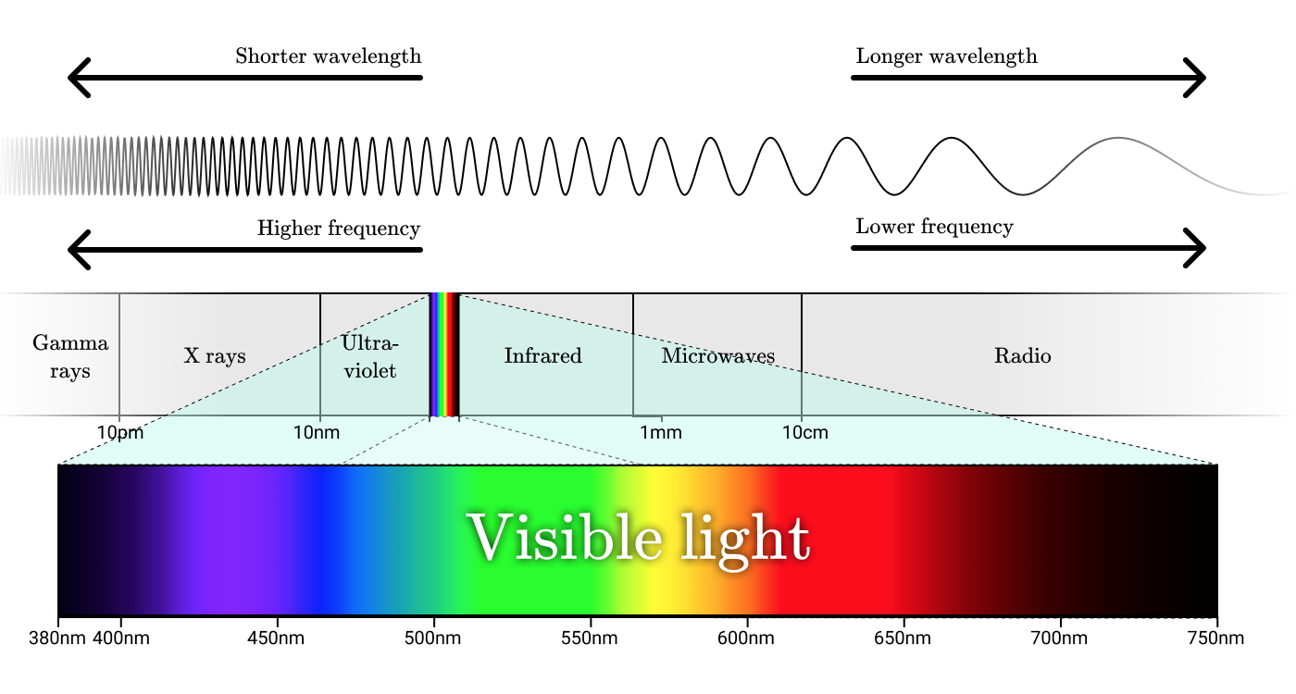
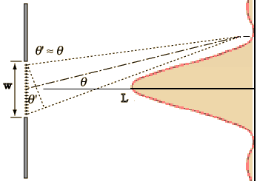
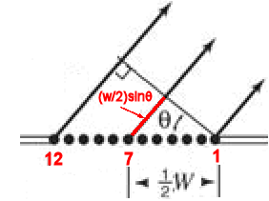
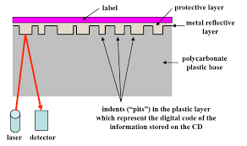
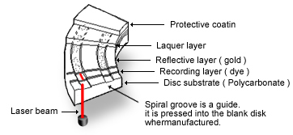
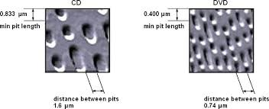
Activity 2. How many lights are needed to express all the colors?
If d=1μm=$1.0×10{\begin{aligned}−6 \\ \end{aligned}}_{}$m
If d=0.1μm, Θ=??
Structure of CD

Slide 14
Activity 2. How many lights are needed to express all the colors?
Look at the sun with a spectroscope.
What color does sunlight have?
Look at the light from the projector with a spectroscope. (Instead of a projector, you can look at a cell phone monitor.)
https://javalab.org/en/color_panel_en/
Notes:
Now, let's look at the projector. When you do not have a projector, you can look at your cell phone monitor.

Slide 19
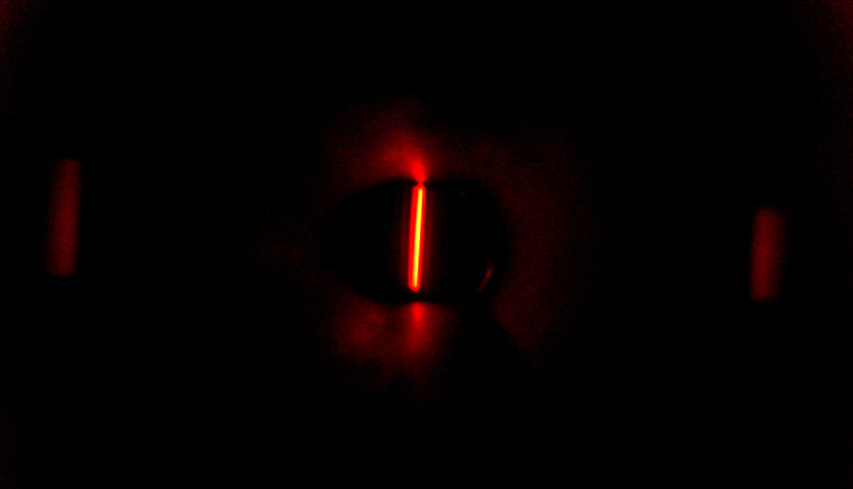
Red

Slide 20
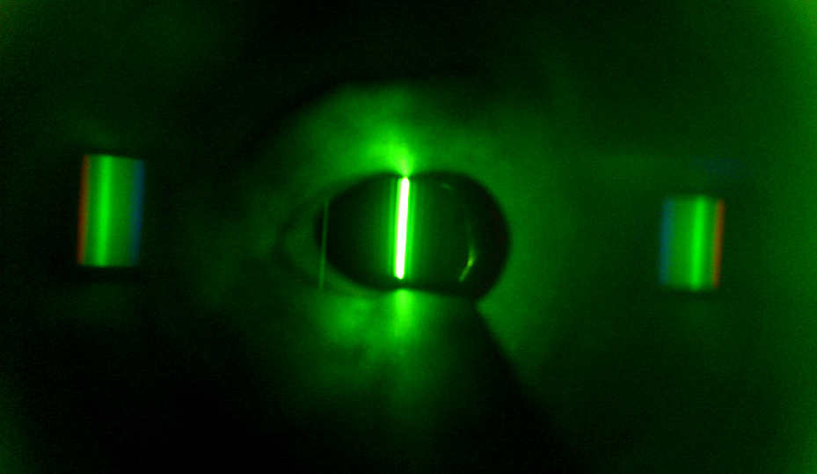
Green

Slide 21
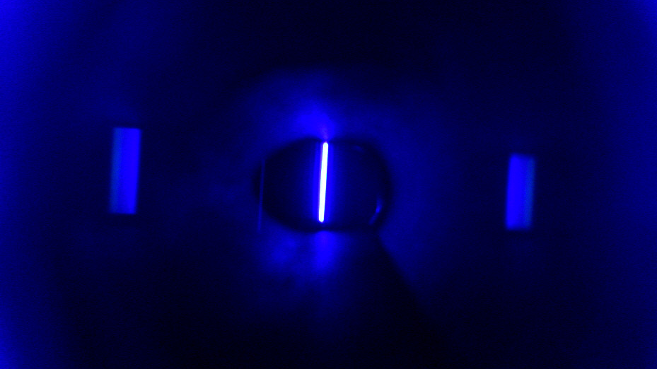
Blue

Slide 22
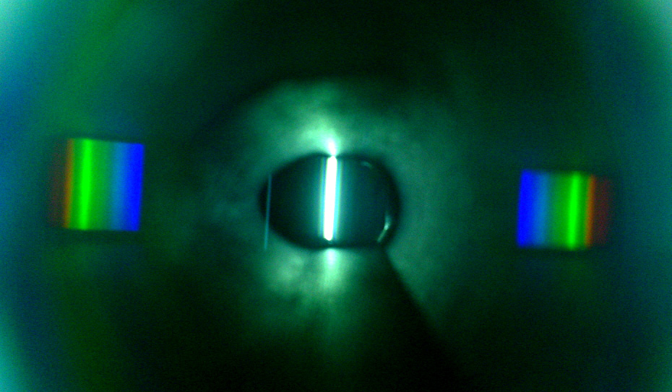
White

Slide 23
Red
Green
Blue
White
Notes:
The spectroscope analyzes what color light has. In addition, each color has a specific position.

Slide 24
Notes:
Now let's compare each of the three colors on one screen.

Slide 26
Notes:
Now let's look at other colors. This is not the primary color.

Slide 30
Notes:
Let's focus on the yellow color.

Slide 31
Notes:
What kind of relationship do you see?
Red + Green = Yellow??

Slide 32
Notes:
Let's focus on the cyan color.

Slide 33
Notes:
Green + Blue = Cyan??

Slide 34
Notes:
Let's focus on the magenta color.

Slide 35
Notes:
Red + Blue = Magenta??

Slide 36
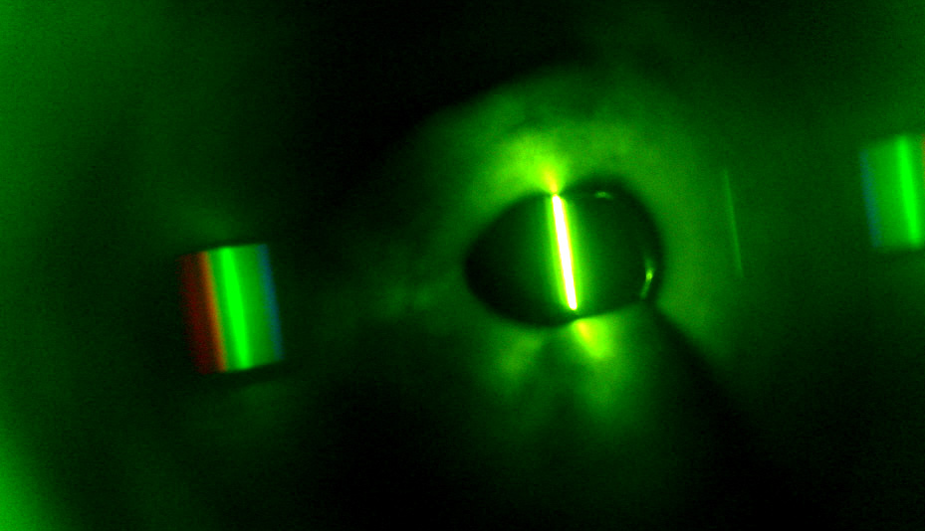
yellow)

Slide 37
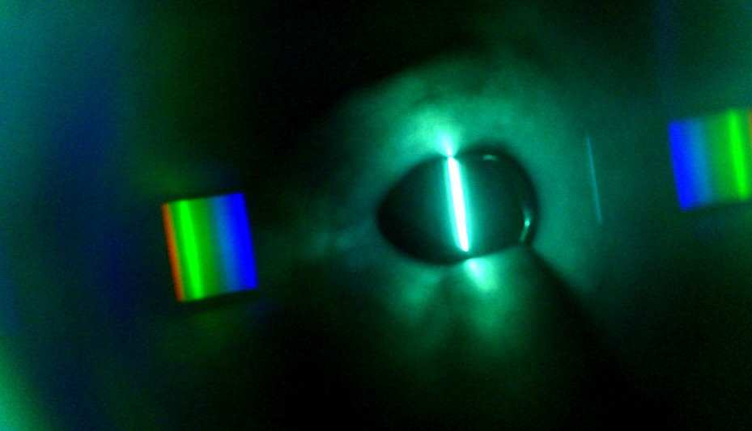
cyan)

Slide 38
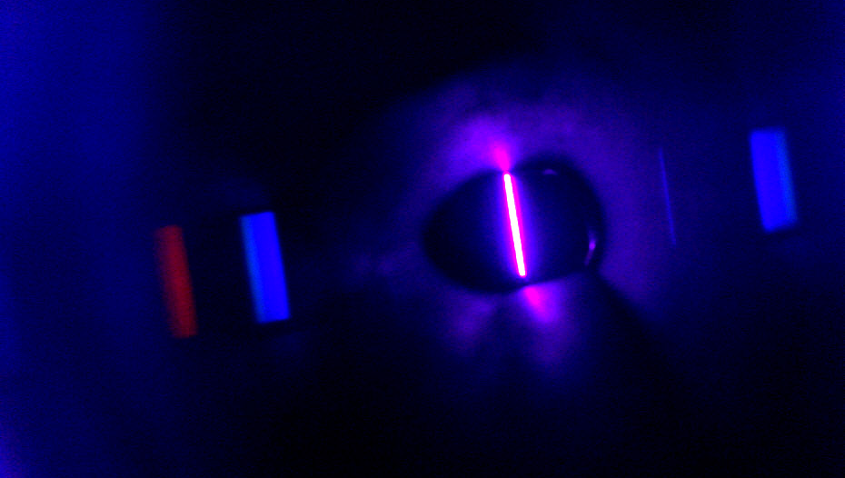
magenta

Slide 39
yellow
cyan
magenta

Slide 41
Activity 2. How many lights are needed to express all the colors?
Let's summarize the results of the spectroscope.
If you are an illuminator, How many colors should be prepared?
Notes:
Imagine that you are an illuminator. You have to use a lot of colored lights on the stage. How can you express various colors? You might be able to prepare all the colored lights to express. For example, use yellow light to represent yellow, and magenta light when magenta is needed. How many colors should be prepared? Is there any ways to reduce the number of colored lights?

Slide 42
Activity 3. A mixture of colors
Notes:
We have two method.

Slide 43
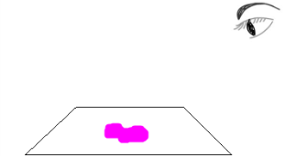
Activity 3. A mixture of colors
Let's illustrate the process of seeing magenta color.
There are two ways to explain this.
Explanation Method 1
This paint reflects the ( ) color of light.
Explanation Method 2
This paint absorbs the ( ) color of light.
Which explanation is a better? What is pigment?
Pigment express a specific color.
In order to, Absorbing the remaining colors
( ) absorbs all colors other than the color to be expressed.
Notes:
We have two method.
First! This paint reflects the (magenta) color of light.
This paint reflects the (red+blue) color of light.
2nd! This paint absorbs the ( green ) color of light.
Do I have to say absorption or reflection? Both are right. But let's think about what action should take place to get the color out. Light of all colors enters the paper.
Colors appear to absorb specific light. Pigments absorb light of a particular color.
absorption? reflect? What is the essence of color? Absorption!!

Slide 44
Activity 3. A mixture of colors
How do pigments represent colors?
Does the pigment absorb color or emit color?
Green+Blue
vs. Cyan= White - Red
Cyan=
Magenta=
Yellow=
R + B
vs. Magenta= W - G
R + G
vs. Yellow = W - B
The pigment reflects the desired color and absorbs the remainder. Will you pay attention to reflection or absorption?
Notes:
We have two method. It is better to explain by absorption.

Slide 45
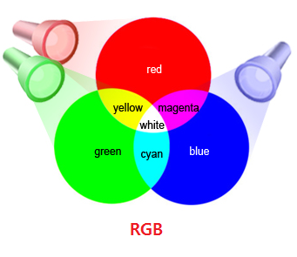
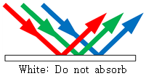
Activity 3. A mixture of colors
The pigment absorbs light other than the color to be expressed.
To express the following color, (light is represented by RGB.)
What color should the pigment absorb light?
The primary colors of light
The primary colors of pigment
What is the relationship between
the primary colors of light and colors of pigment?
are Red, Green, Blue.
are Cyan, Magenta, Yellow
Notes:
2.
3. All light is white, that is, there is no color. To express color, one must be missing.

Slide 46
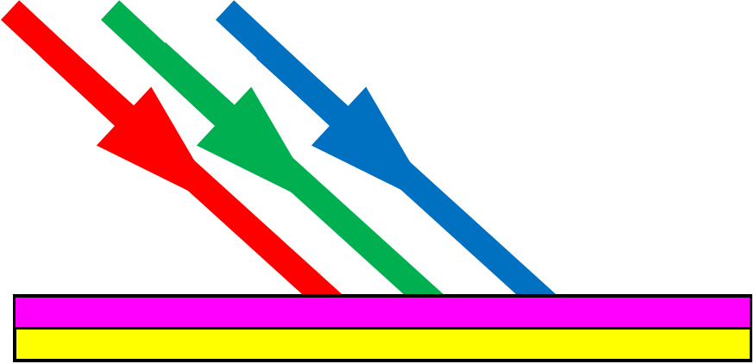
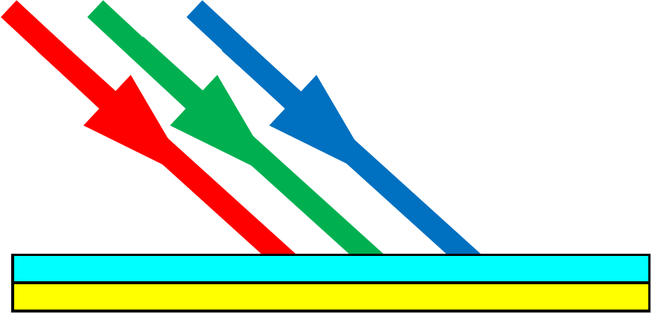
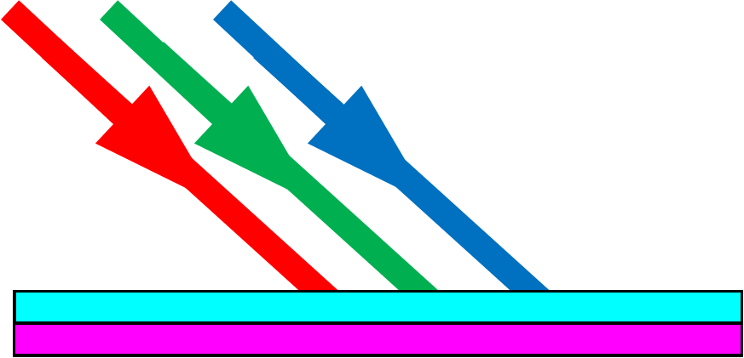
Activity 3. A mixture of colors
A mixture of colors (pigment)
M+Y C+Y C+M C+Y+M
Notes:
It is difficult to explain the synthesis of colors if you describe the color with reflection.
However, it is very easy to explain color by absorption.
In the case of (M + Y), it is difficult (R + B) + (R + G)
However, it is easy to explain that (W-G) + (W-B).

Slide 47
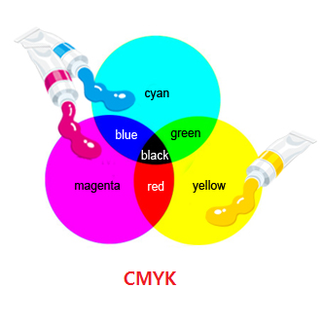
Activity 3. A mixture of colors
Mixing light makes it brighter : Additive mixture,
Mixing pigment makes it darker : subtractive mixture
: Red, Green, Blue.
: Cyan, Magenta, Yellow
Notes:
Mixing light makes it brighter : Additive mixture,
Mixing pigment makes it darker : subtractive mixture

Slide 48
Activity 4. The principle of color printing
Notes:
We have two method.

Slide 49
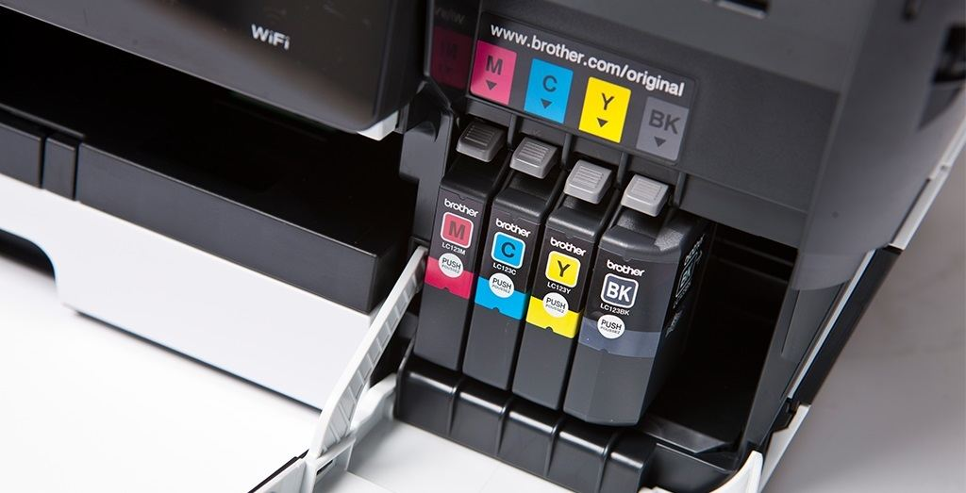
Activity 4. The principle of color printing
There are four types of inks used in color printers: cyan (C), magenta (M), yellow (Y), and black (K).
Cyan, Magenta, Yellow , blacK

Slide 50
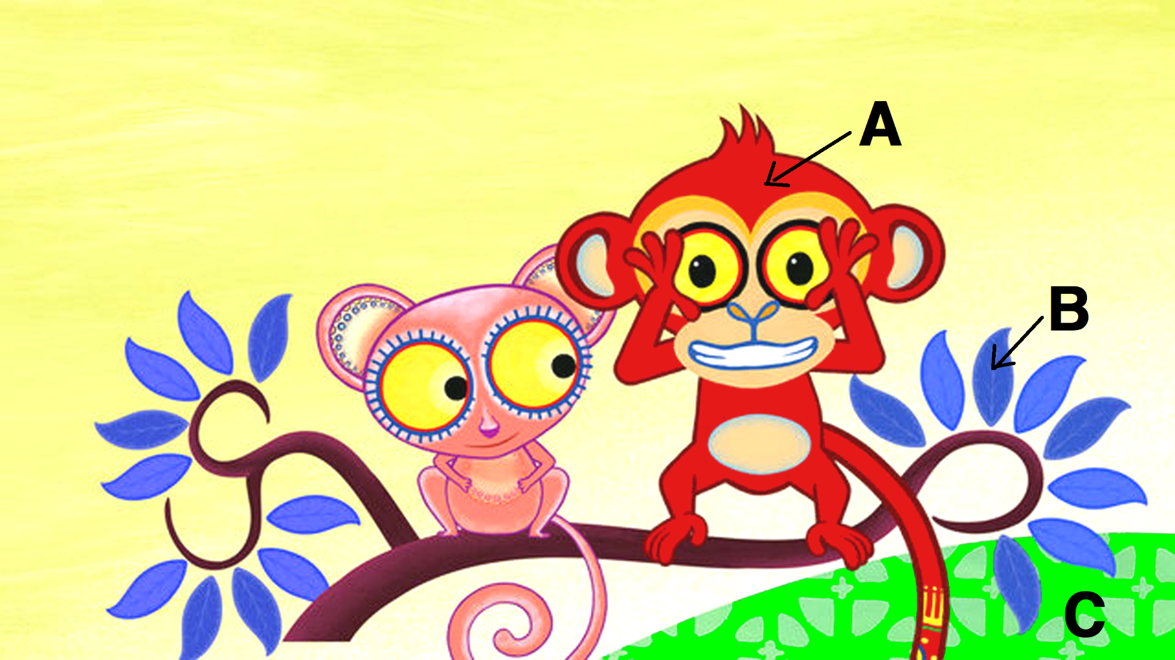
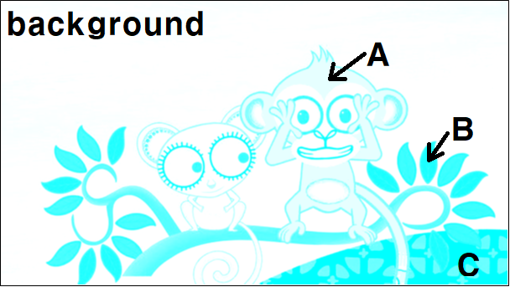
Activity 4. The principle of color printing
There are four types of inks used in color printers: cyan (C), magenta (M), yellow (Y), and black (K).
Cyan, Magenta, Yellow , blacK
The following figure shows the amount of CMYK sprayed when printing a picture.
What color will appear when each ink is combined?
Consider the color of each part

Slide 51
Thank you!!!

