Slide 1
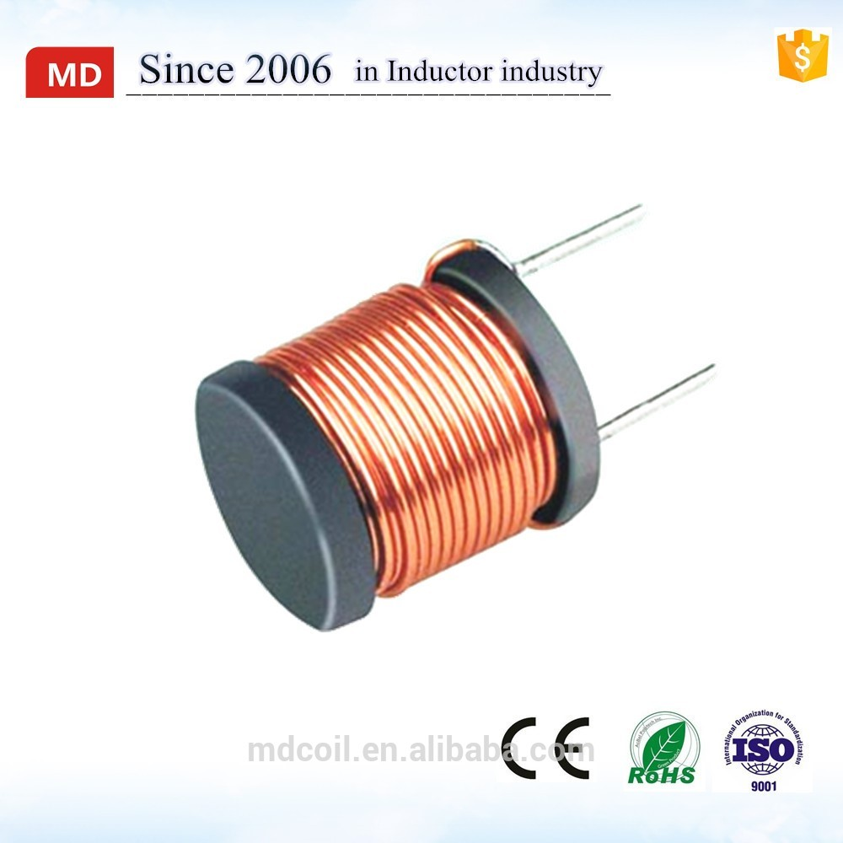

Dealing with inductor
자바실험실 JavaLab.org

Slide 2
What the inductor does
Magnetic field’s change
Electric energy
Can make the electric energy.
Can convert the voltage.
Can send radio waves.
Can capture radio waves.

Slide 3
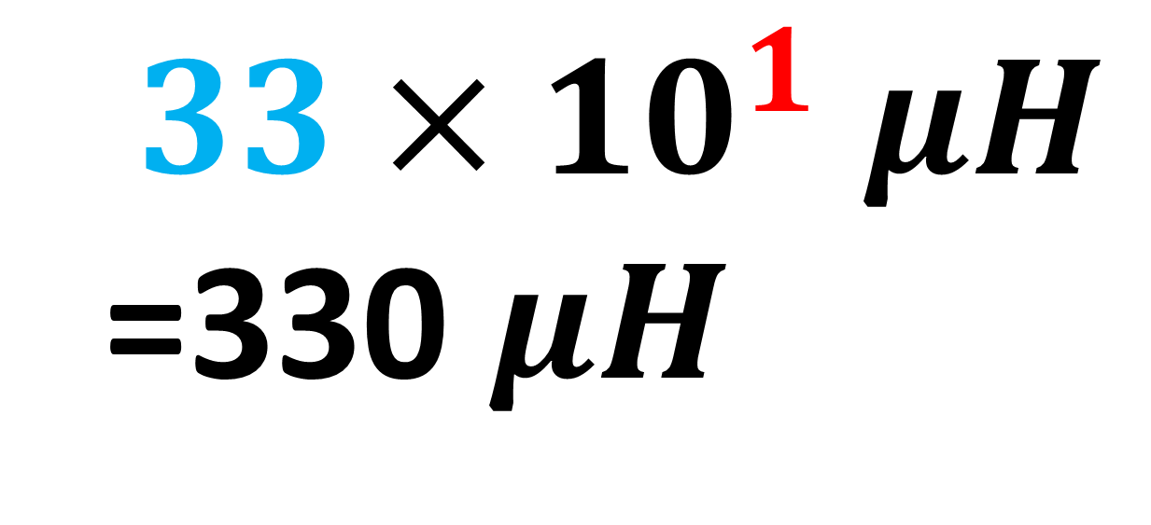
What means the number on the top of the inductor?
331
331
$$33×{10}^{1} μH$$
=330 $μH$

Slide 4

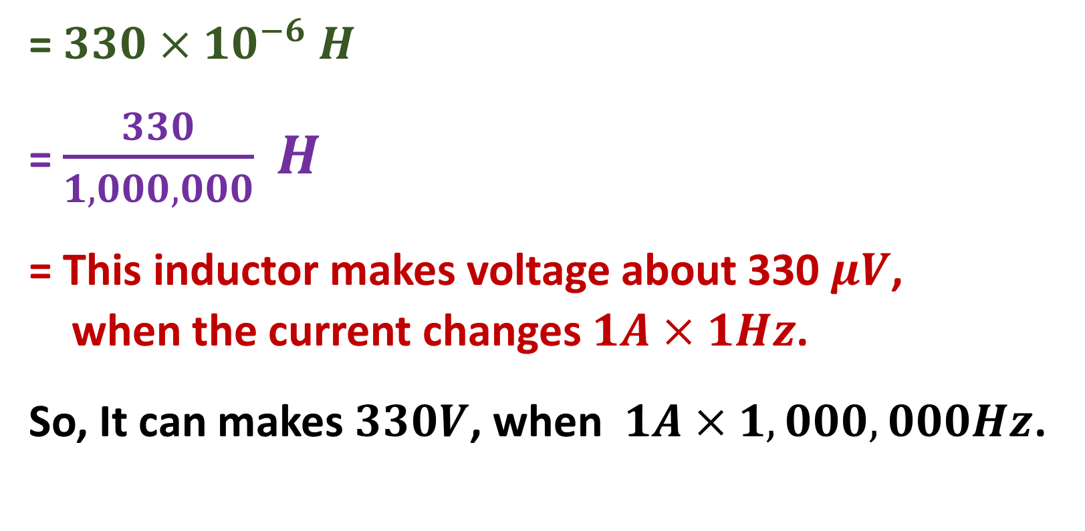
330 $μH$ means,
331
= $330×{10}^{−6} H$
= $\frac{330}{1,000,000} H$
= This inductor makes voltage about 330 $μV$,
when the current changes $1A×1Hz$.
So, It can makes $330V$, when $1A×1,000,000Hz$.

Slide 5
Breadboard
…
4
3
2
1

Slide 6
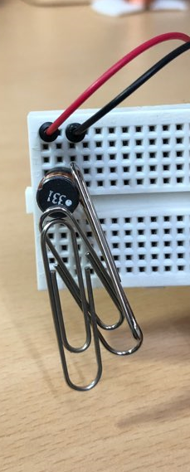
331
1
1
2
3
3
4
5
Activity 1. Electromagnet
7
8
9
10
11
12
13
14
15
16
17

Slide 7
In “Activity 1”, what will be ( A ), ( B ) ?
( A )
( B )

Slide 8
In “Activity 1”, what will be ( A ), ( B ) ?
Unchanged Magnetic field
Electric current

Slide 9
331
1
1
2
3
3
4
5
5
Activity 2
7
8
Mutual
inductance
9
10
11
12
13
14
15
16
17

Slide 10
When you press a button,
331
1
1
2
3
3
4
5
5
Activity 2
7
8
Mutual
inductance
9
10
11
12
13
14
15
16
17

Slide 11

In “Activity 2”, what will be ( C ), ( D ) ?
( C )
( D )
Light

Slide 12
In “Activity 2”, what will be ( C ), ( D ) ?
Change of magnetic field
Electric current
Light

Slide 13
What we need to know.
To light the LED, it requires higher voltage(> 3V)
We can get higher voltage by using this inductor.

Slide 14
Activity 3. Self inductance

Slide 15
When you connect the circuit,
the inductor produces unchanged magnetic field.

Slide 16
When you cut the circuit,
The inductor makes voltage in order to against the magnetic change

Slide 17
In “Activity 3”, what will be ( E ), ( F ) ?
( E )
( F )
Light

Slide 18
Bonus Activity
Wireless power transmission
331
1
2
3
3
331
5
5
C1815
6
7
8
9
10
* The two inductors are opposite in direction
11
12
13
14
15
16
17

Slide 19
Monitoring inductor
(makes a frequency)↓
331
1
2
3
3
331
Main inductor →
5
5
(switching the main current)
← Transistor
7
Main
current
8
9
10
11
12
13
14
15
16
17

Slide 20
Choose the answer from below.
Electric current
Change of magnetic field
Unchanged Magnetic field

